Slide 1
Power BI RLS
Row Level Security

Slide 2
What you will need?
Power BI Desktop
Power BI Pro Subscription to publish to Power BI Service
Excel File from AdventureWorksDW
Notes:
Excel File with AdventureWorkDW
https://github.com/peterperov/PowerBIServer/raw/master/RowLevelSecurity/AdventureWorksDW2012.xlsx

Slide 3
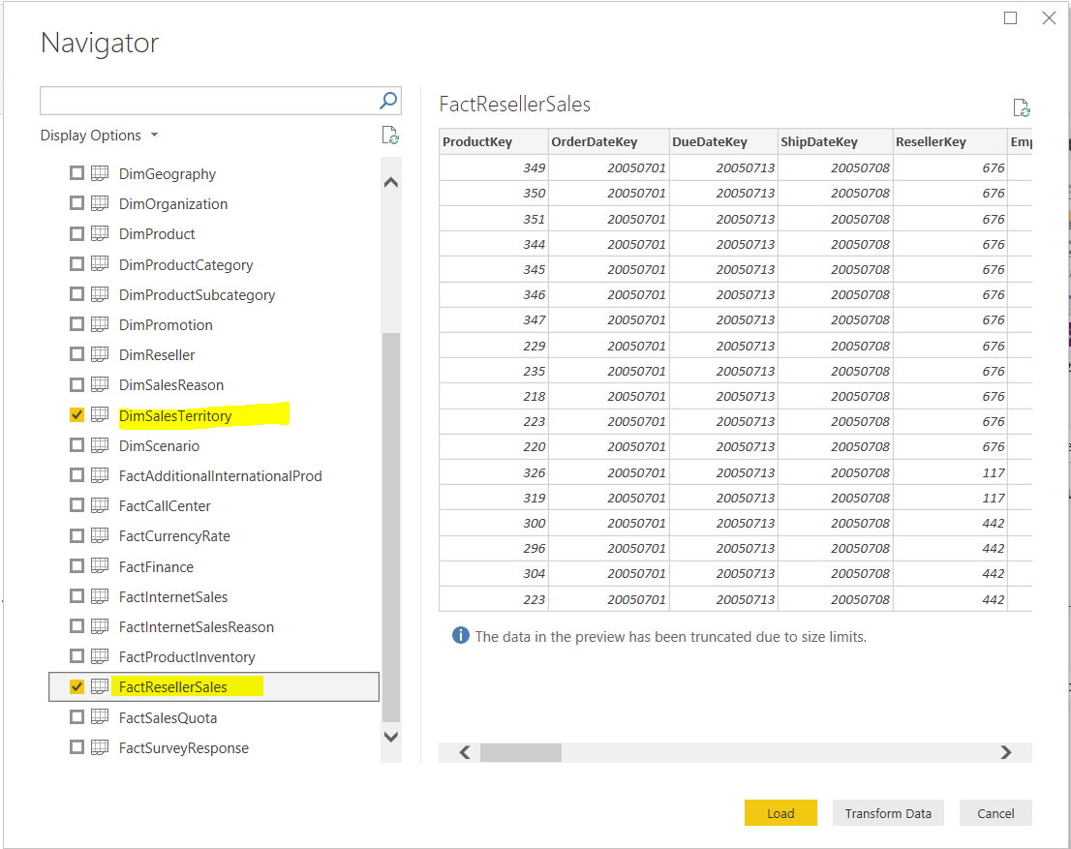
Create Power BI Report
Import Data
Get Data -> Excel
Browse to the Excel file
Import Selected data

Slide 4
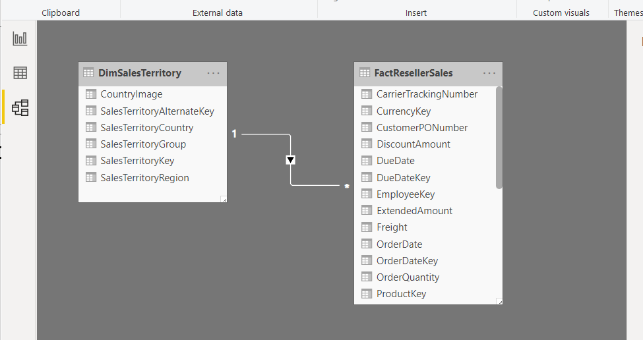
Data relationships are picked automatically

Slide 5
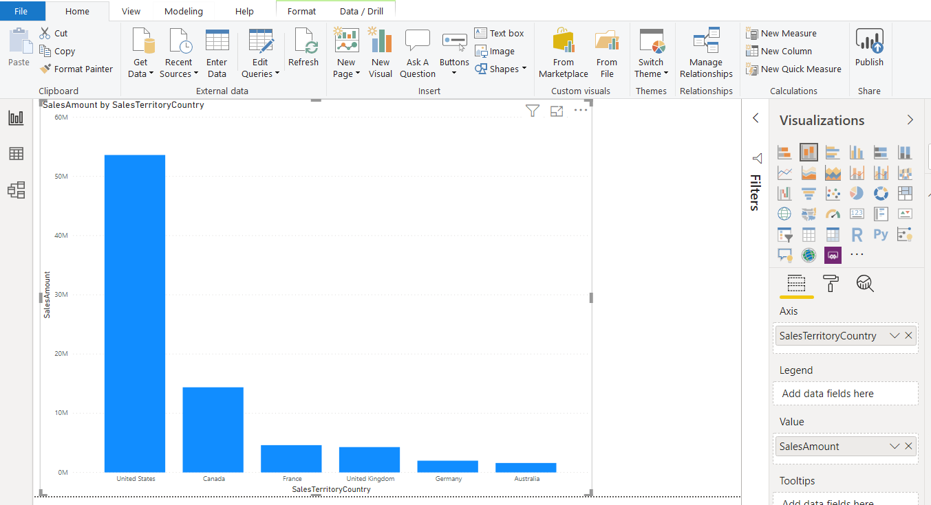
Build simple graph report

Slide 6
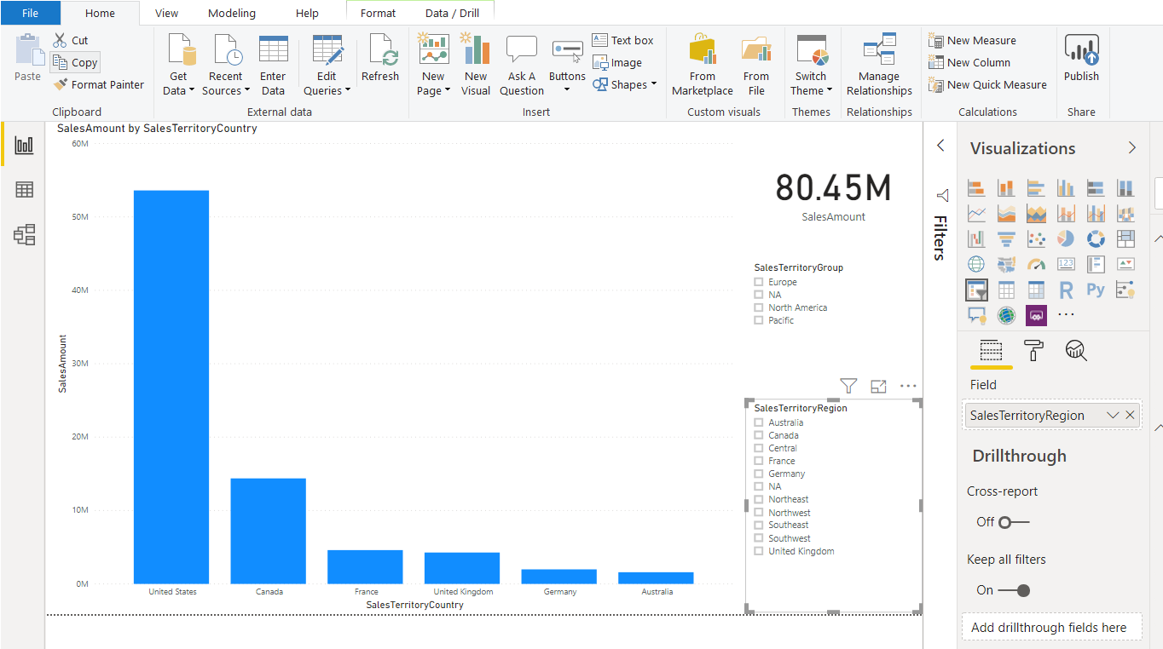
Add vCard and 2 slicers

Slide 7
Let’s create Roles

Slide 8
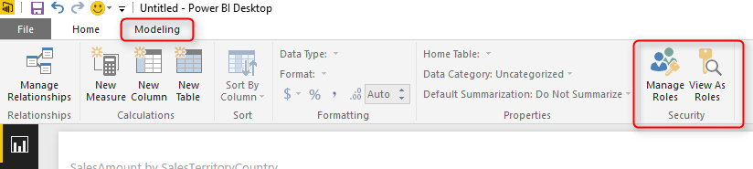
Role creation is accessible from Manage Role

Slide 9
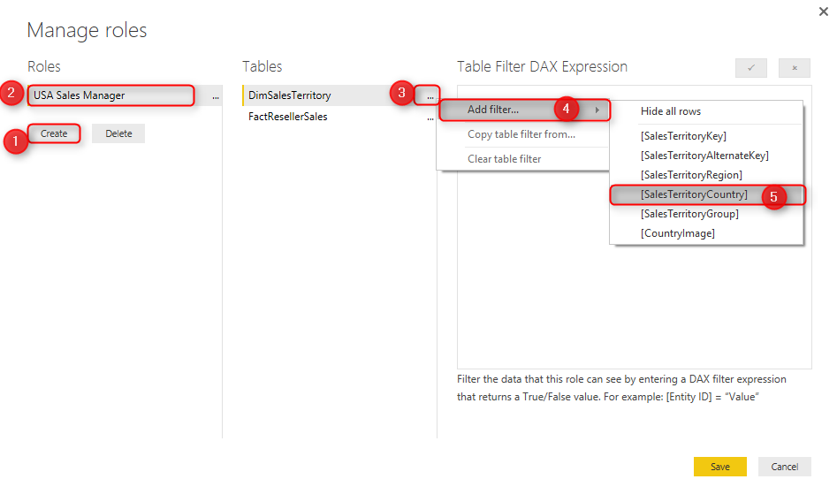
Create Name of the Role and set up filter

Slide 10
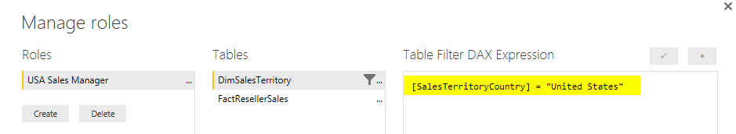
USA Sales Manager Role

Slide 11
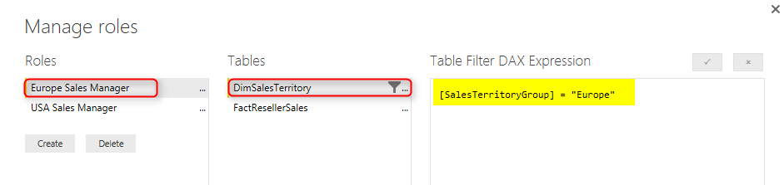
Europe Sales Manager Role

Slide 12
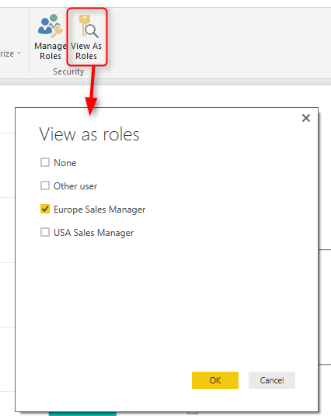
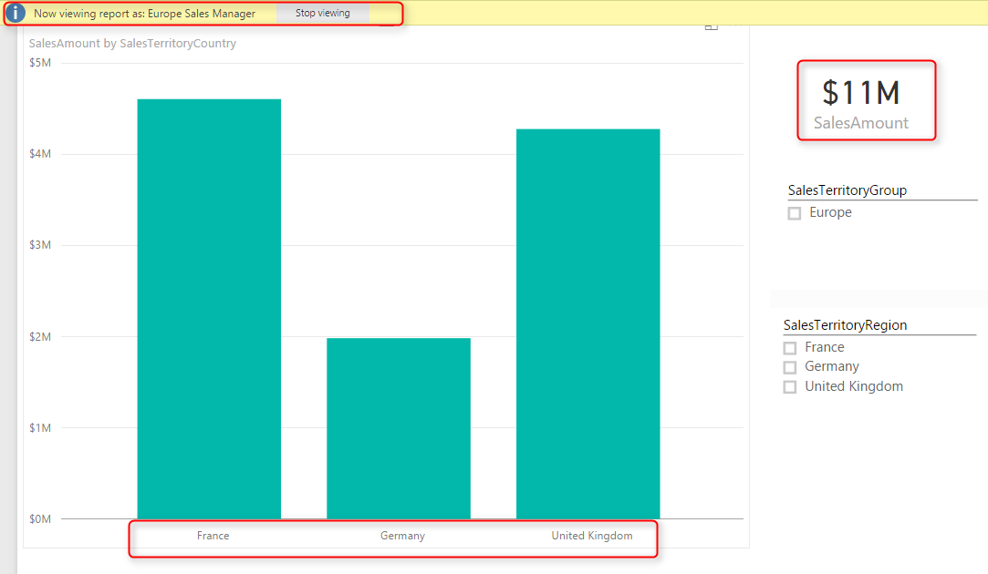
You can test the roles by clicking on View As Role

Slide 13
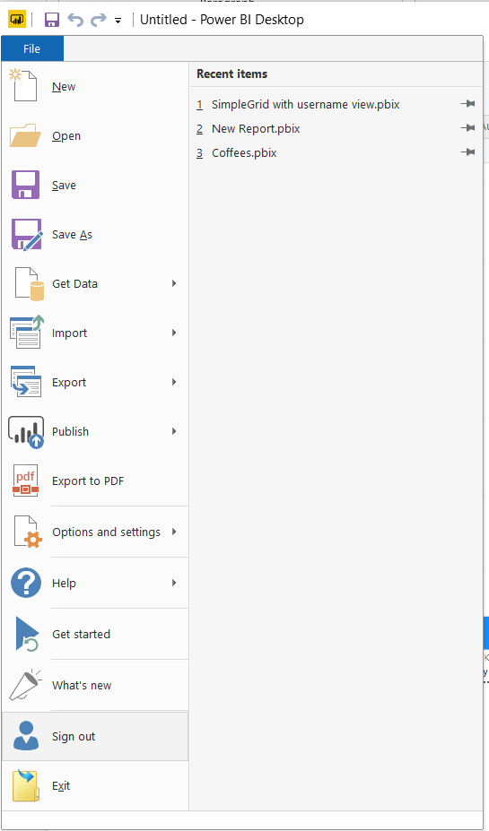
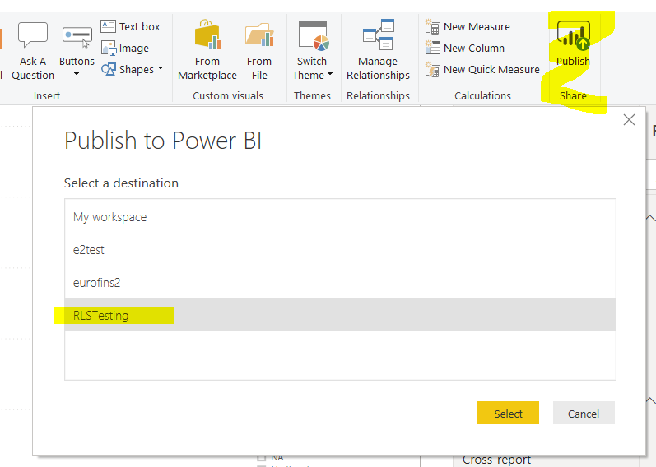
Sign in and upload the report to Workspace
Notes:
Signin to your Power BI Server account

Slide 14
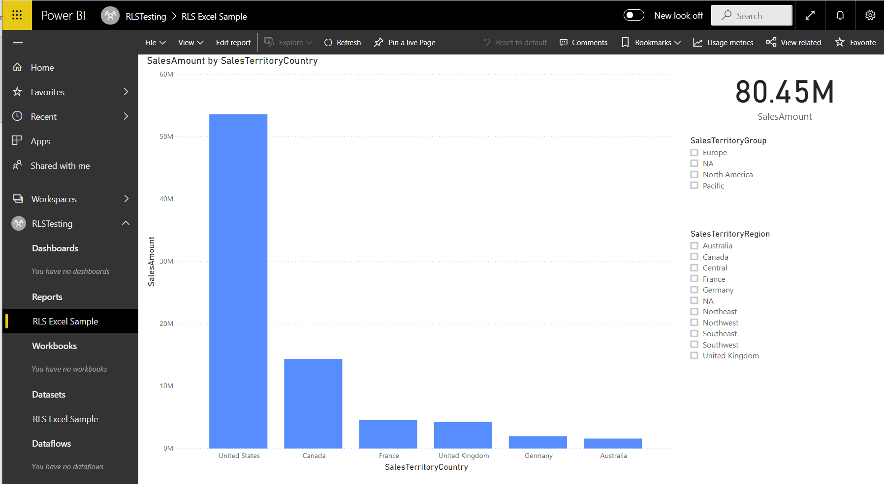
Report is now accessible in Power BI Service

Slide 15
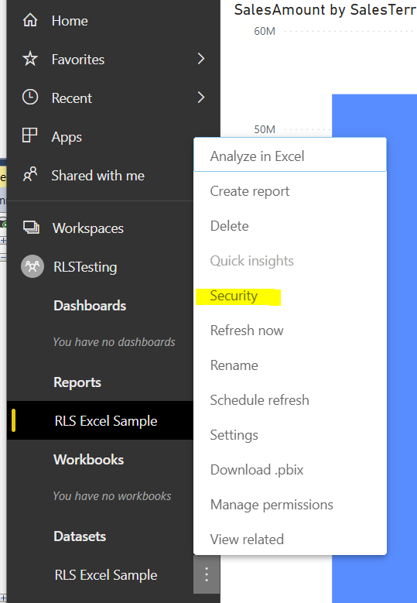
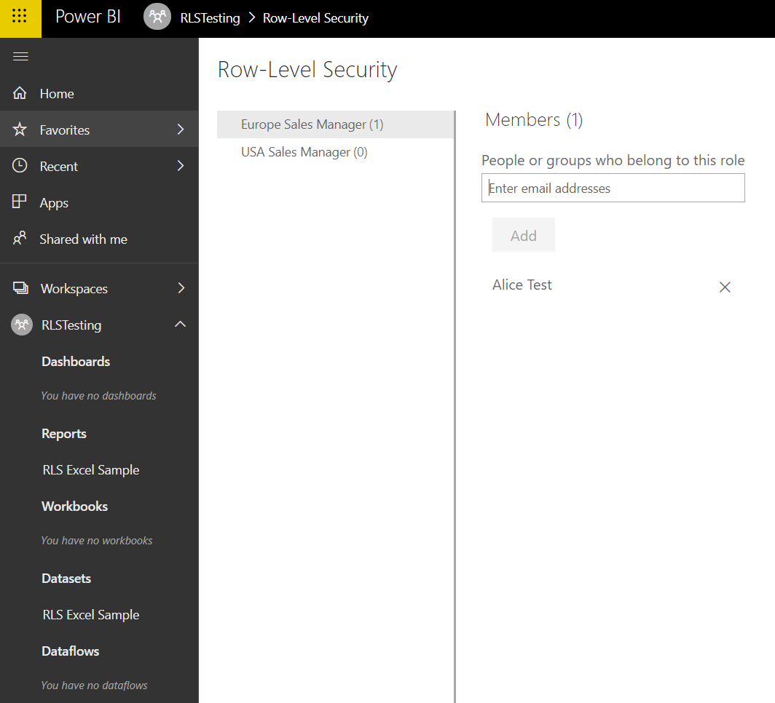
Access role security definition in PBI Service
Notes:
alice@eurofins2.onmicrosoft.com is a test user assigned to Europe

Slide 16
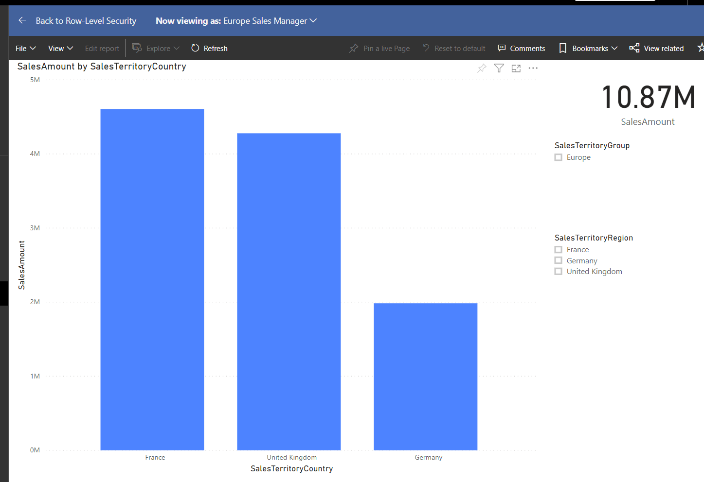
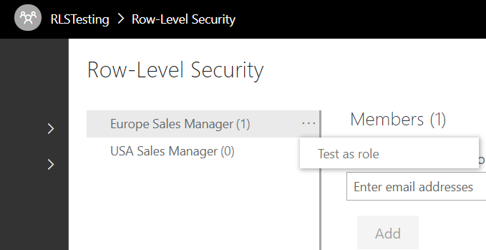
Testing the role

Slide 17
Conclusion
RLS defines the roles on a report level
Roles can be populated in DataSource security definition in PBI
Cons
Report authors should be extremely careful when defining roles
Somebody needs to manage roles for each report
Possible to create role for every company and populate it with users but this is not scalable

